Slide 1

The Problem Statement
In New York State, 35% of the 75% of energy lost as waste heat comes from residential homes. This unused heat is expensive and contributes to climate change.
Notes:
70 percent of all energy used to create heat is wasted. 35% of energy in homes in wasted.
We focused on homes, because we have more experience with waste heat in homes.

Slide 2
Fireplace
Kitchen
Dryer
Furnace
Water
Heater
AC
Examples of heat produced by typical household appliances:
A water heater produces 720 watts for an hour of heat
A dryer produces 2.1 kw hour of heat
A stove produces 3.0 kw hour of heat *
A furnace produces 5.5 kw hour of heat**
* Stoves these days are typically around 75-80% efficient.
** Assumes a 50 gallon water heater (according to the DOE most household have water heaters between 20 and 80 gallons)
Notes:
* Stoves these days are typically around 75-80% efficient.
** Assumes a 50 gallon water heater (according to the DOE most household have water heaters between 20 and 80 gallons)

Slide 3
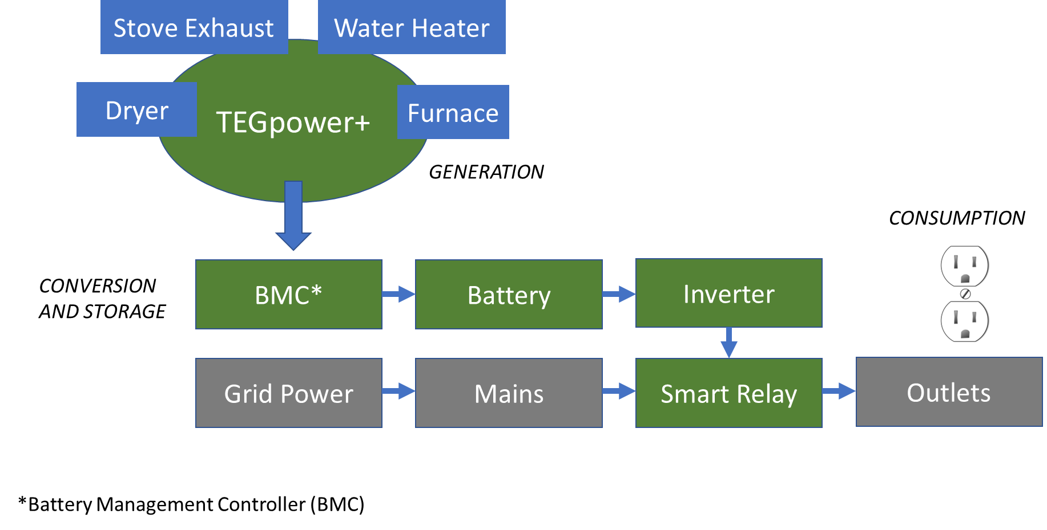
Our Solution…
Our solution is called TEGPower+. It uses thermoelectric generators (TEGs) to create electricity out of waste heat generated from both residential and commercial clothes dryers. It works by positioning tegs on the outside of a dryer duct insert so that the TEGs are able to be heated by the air traveling through the duct. As the electrons on the cold side of the TEG are heated, electricity is generated and stored in a battery for later use.
Materials in the TEG:
Bismuth Telluride Lead telluride, or silicon germanium.
Cold side of TEG is made up of anium (SiGe) and the hot side is made up of bismuth (Bi2Te3) telluride, lead telluride (PbTe) and Silicon germanium.
https://inventoryllama.jonahmorgan1.repl.co/

Slide 4
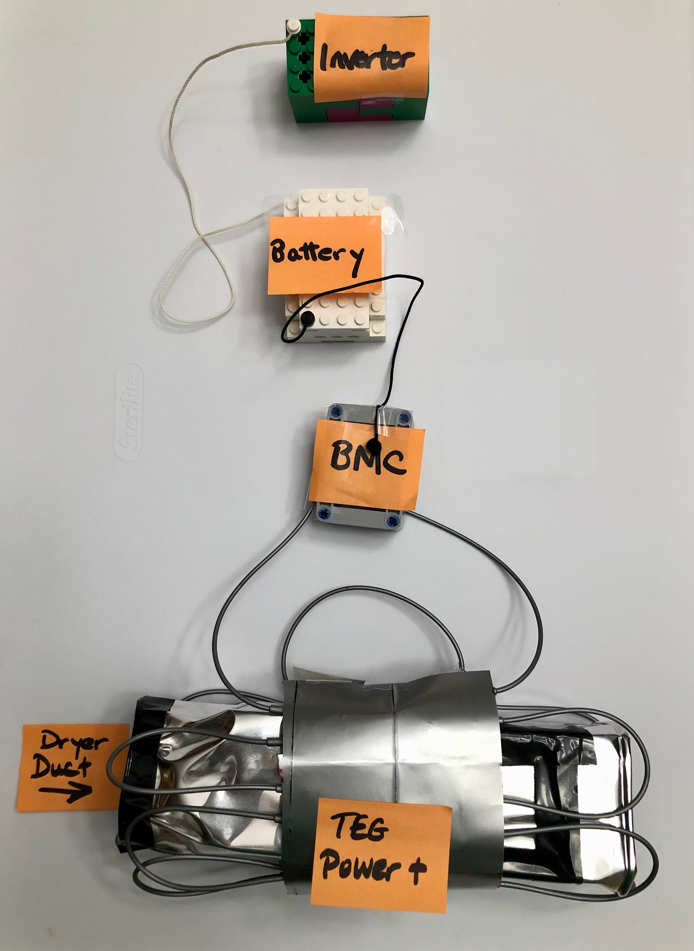
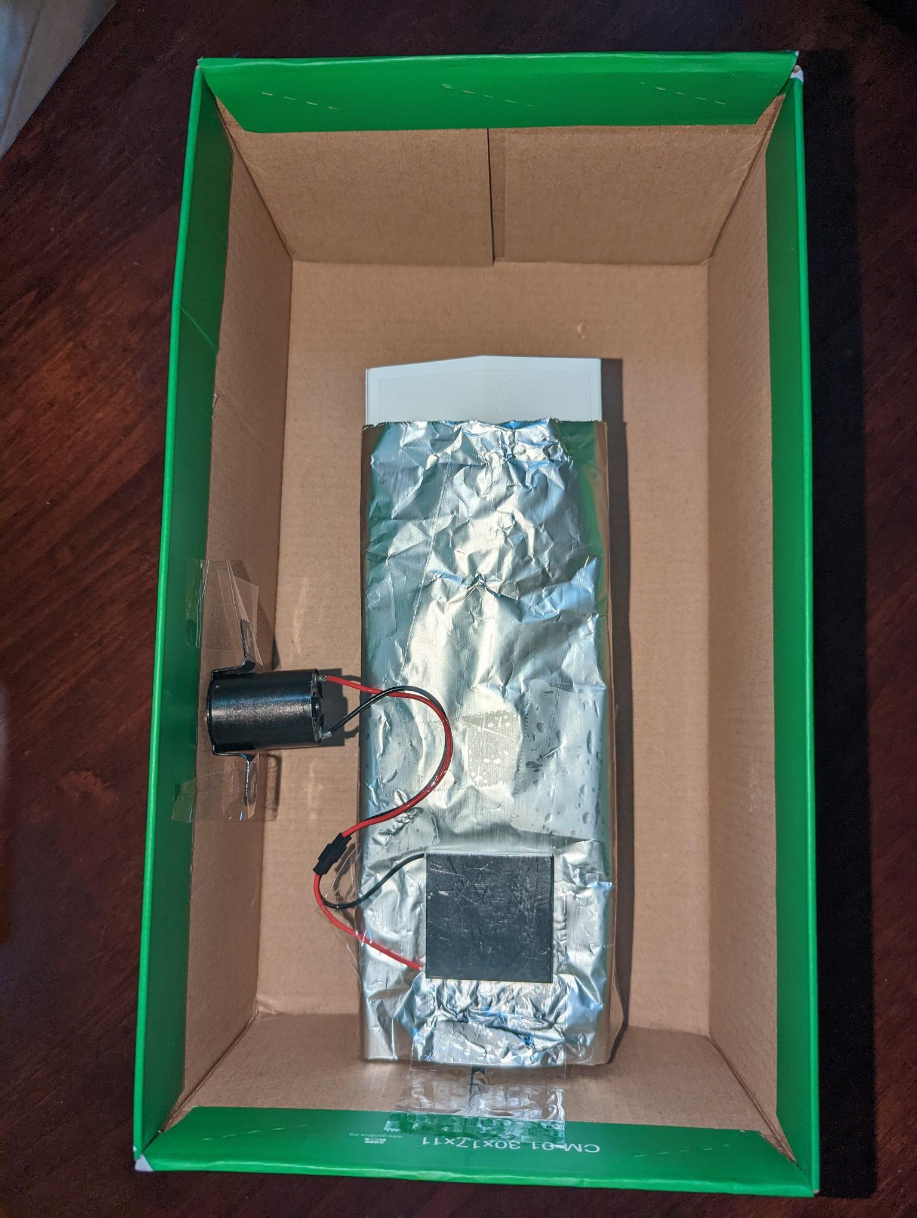
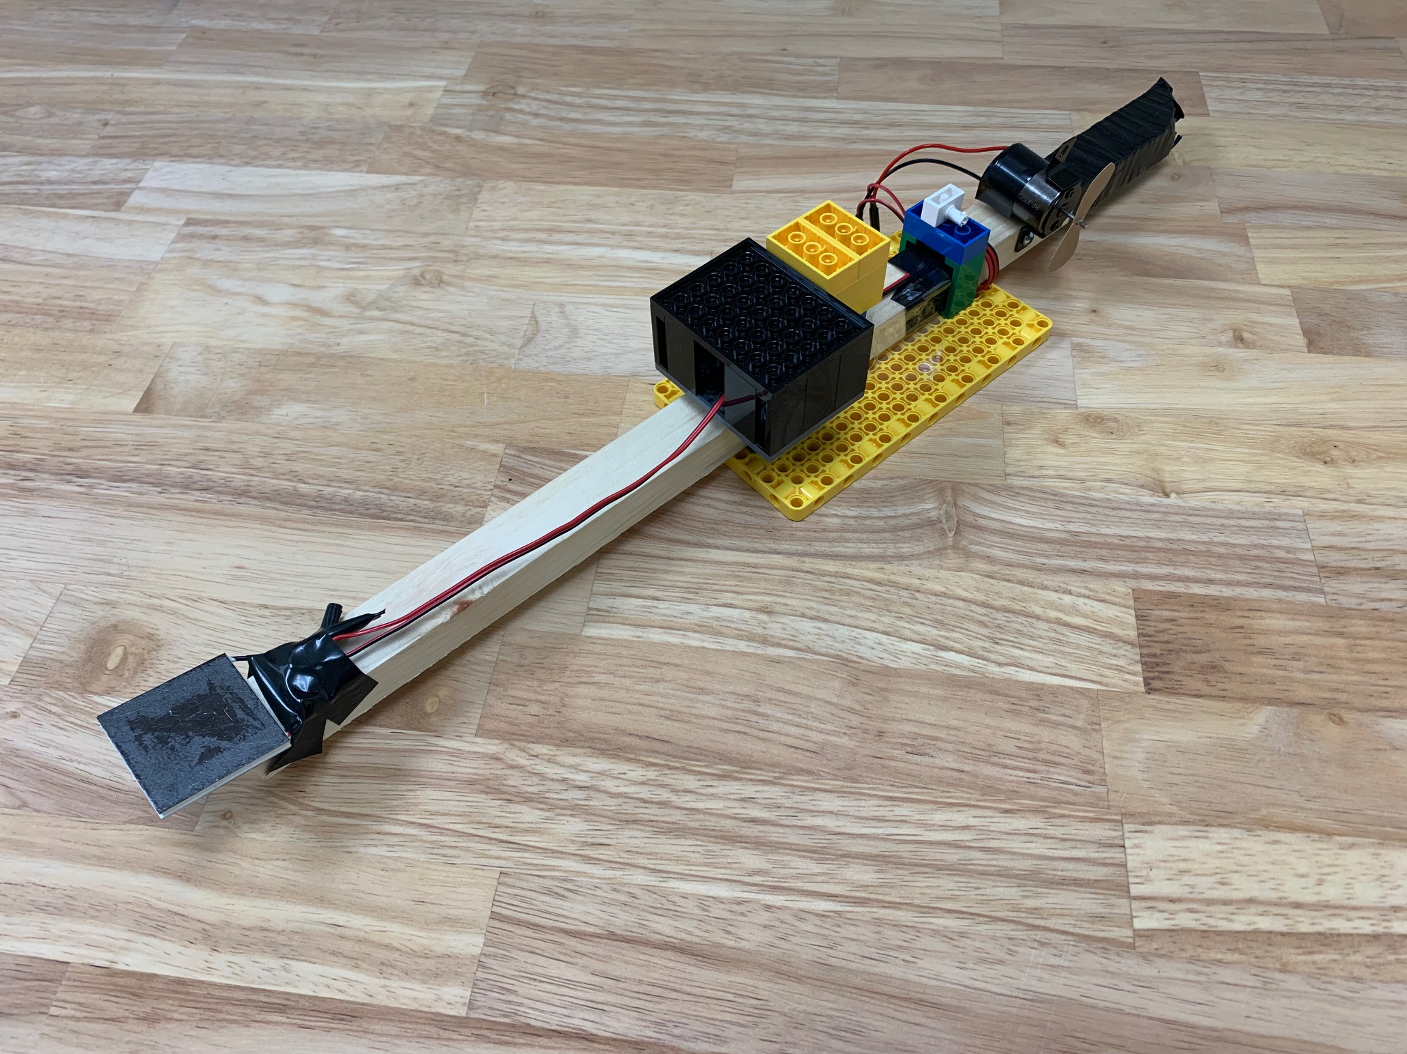
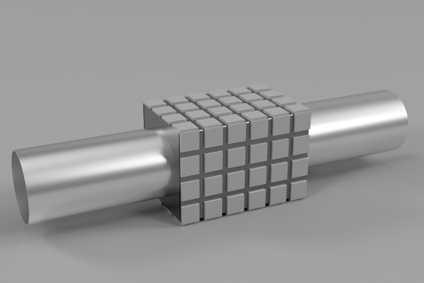
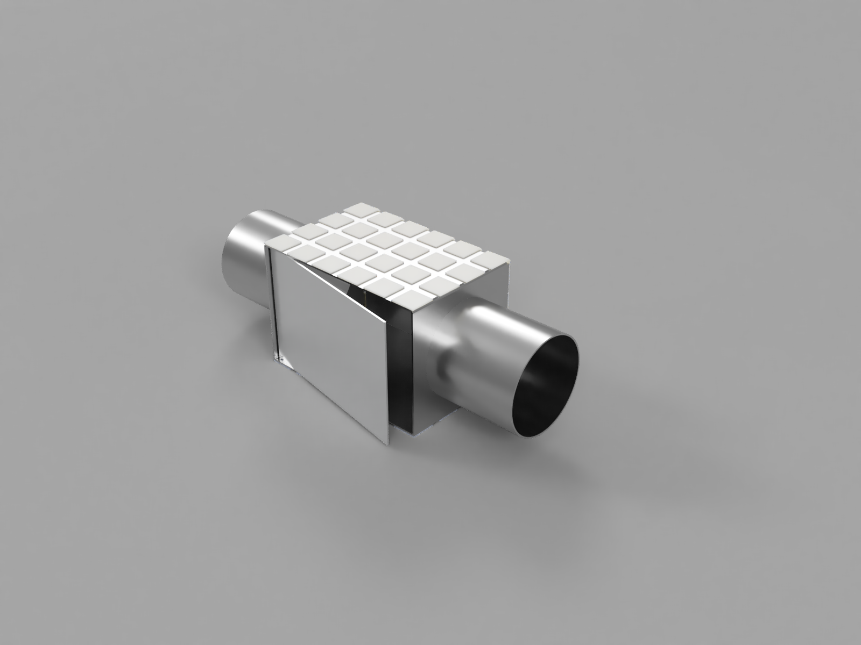
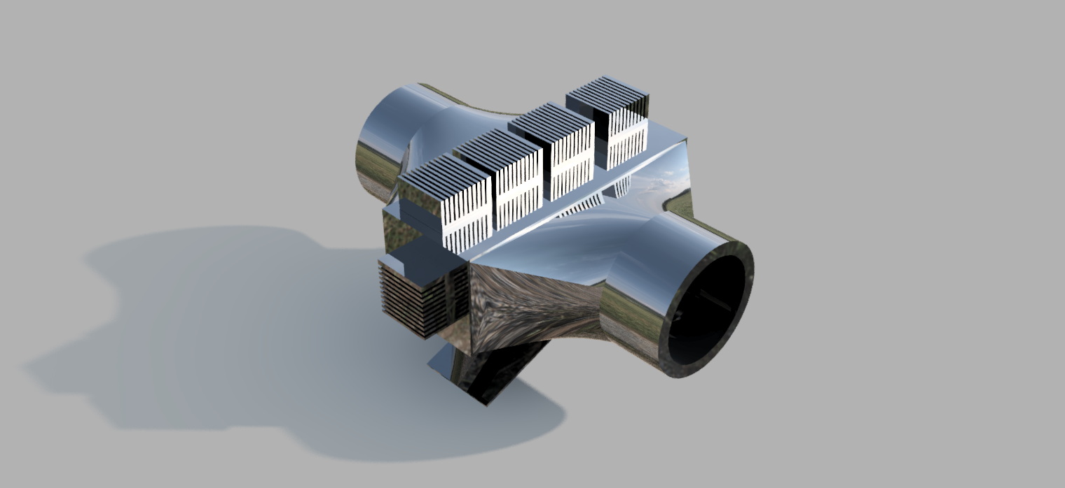
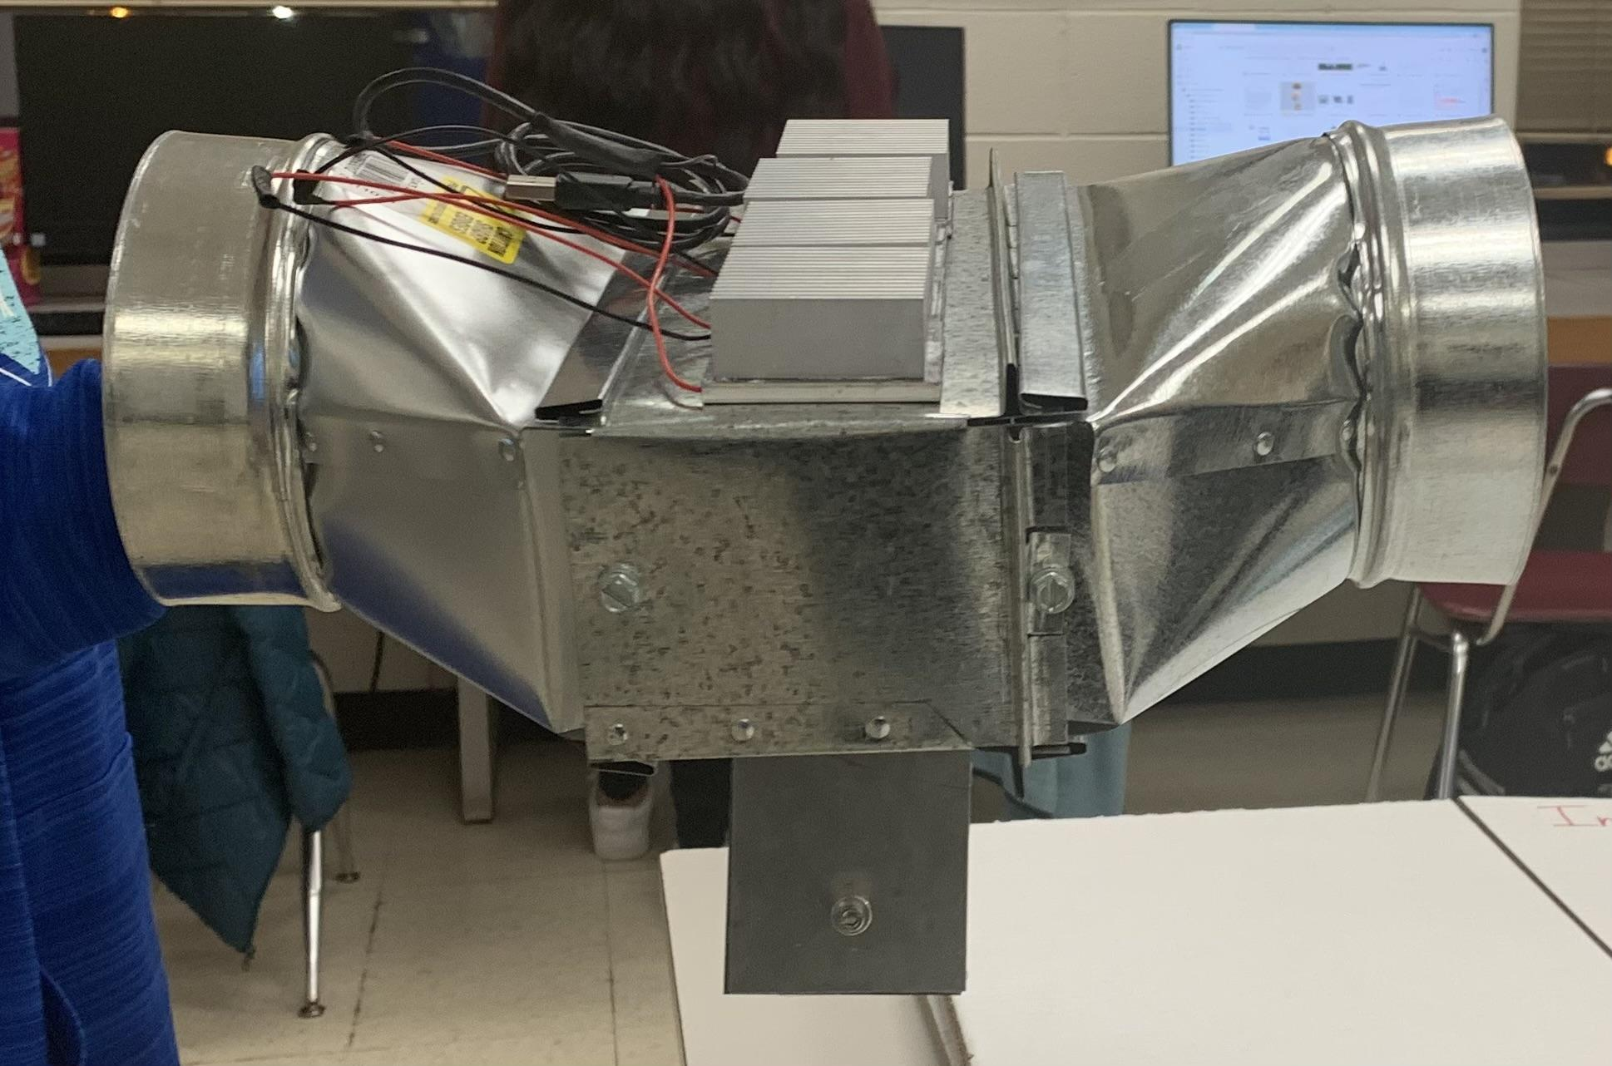
Champs
Feb. 18, 2023
Model/Prototype Iteration
Start of Season
Aug. 2022
Nov 26: LEGO Prototype v2
Working model but not cost-efficient nor reliable.
Jan 13: CAD v1
The original CAD has 72 TEGs to produce 72 watts.
Nov 19: Prototype v1
Prototype failed to work, new one was made.
Oct 21: LEGO Prototype Plan
Jan 20: CAD v2
Added a trapdoor to remove lint and dust that might pile up.
Feb 5: CAD v3
Trapdoor was added again, heat sinks were also added
Feb 10: Final Prototype
Built based off on CAD v3 fully, built with wires. Produces 76 watts from four 19-watt TEGs

Slide 5

Creative Commons zero v1.0 Universal License
The Creative Commons CC0 Public Domain Dedication waives copyright interest in a work you've created and dedicates it to the world-wide public domain. Use CC0 to opt out of copyright entirely and ensure your work has the widest reach. As with the Unlicense and typical software licenses, CC0 disclaims warranties. CC0 is very similar to the Unlicense.

Slide 6
Prototype of a Customized TEGPower+ Version
(Works On Clothes Dryer Vent)
This version of our solution uses 6 thermoelectric generators (TEGs) to create electricity out of waste heat generated from clothes dryers. Our solution also includes a box, which is made out of sheet metal, that is surrounded by the TEGs. Then, on top of each TEG, there is a light aluminum heat sink to make the temperature differential higher. The box is also secured in between the dryer vent, to slow down the air flow and to make the TEGs capture more heat. To clean the lint, there is also a trap door located on the bottom of the box to make your cleaning easier. The TEGs start to work when the hot air is blown through the pipe. As the electrons on the cold side of the TEG are heated, electricity is generated and stored in a battery for later use.
CAD Image of what TEGPower+

Slide 7
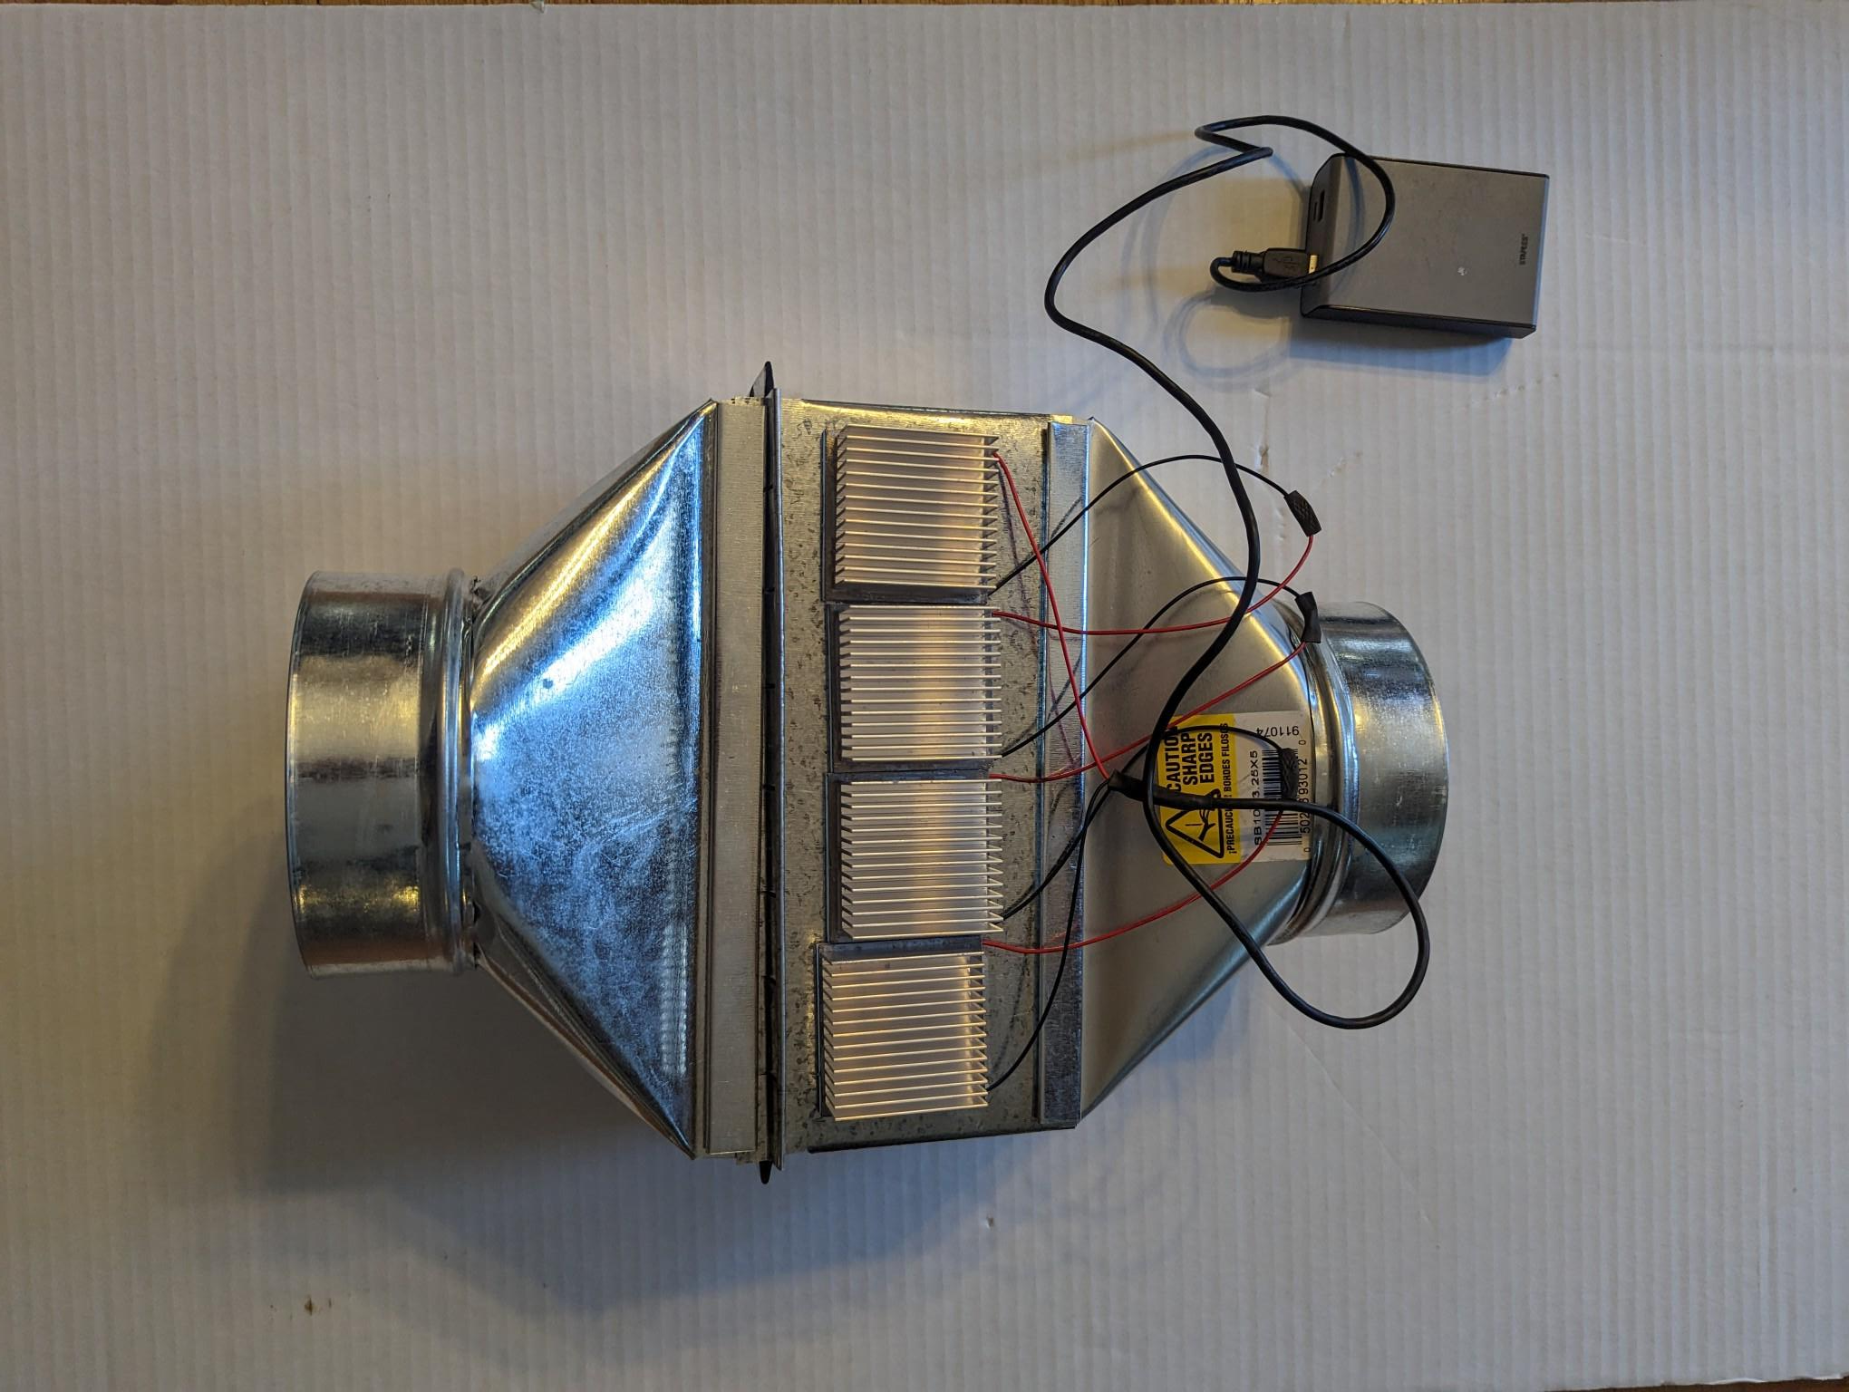
Working Prototype TEGPower+

Slide 8
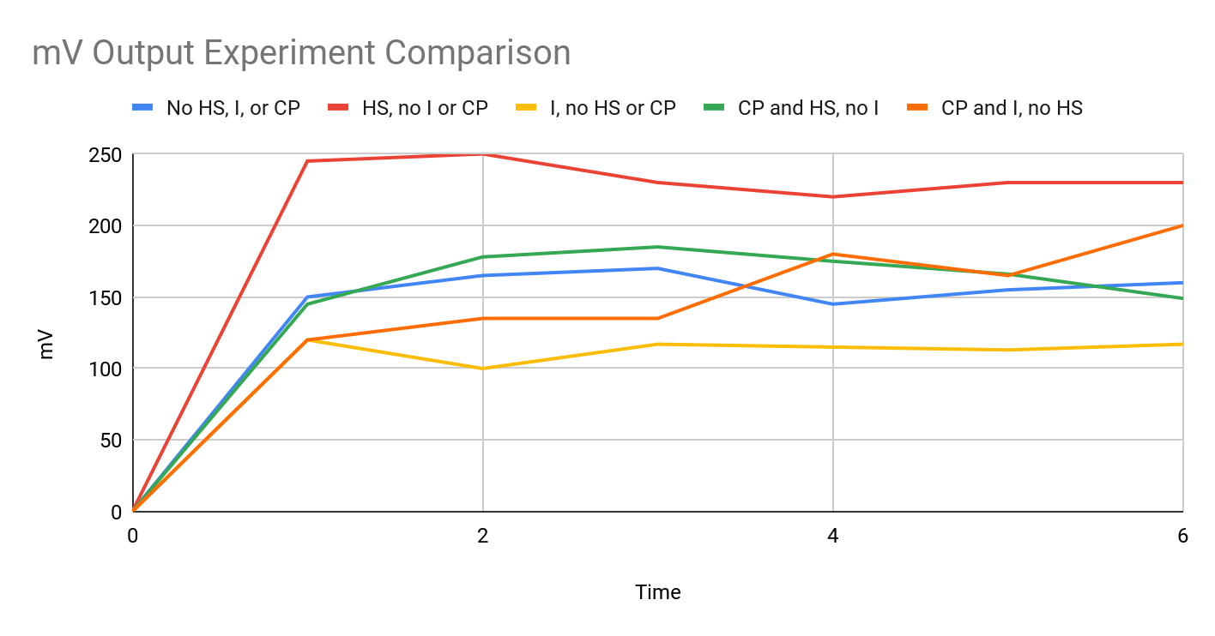
Notes:
Line graph Observation: Experiment 2 produces the highest mV With Heat Sink but no Ice or Copper Plate. We believe the metal duct work is a thinner than the copper plate which is may be the reason we got a better result. Another possible reason is that copper distributes the heat better and create a lower differential.

Slide 9
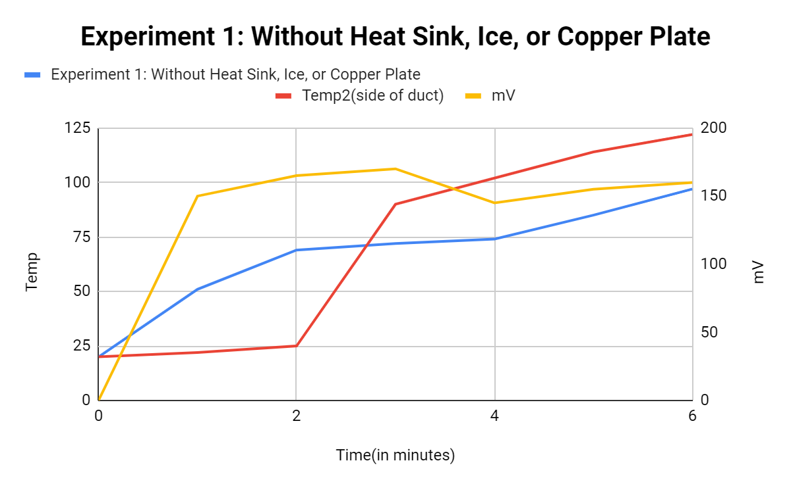
Experiments:
Experiment 1: Without Heatsink, Ice, or Copper Plate
Time(in minutes) | Temp1(top outside of duct) | Temp2(side of duct) | mV
0 | 20 | 20 | 0
1 | 51 | 22 | 150
2 | 69 | 25 | 165
3 | 72 | 90 | 170
4 | 74 | 102 | 145
5 | 85 | 114 | 155
6 | 97 | 122 | 160

Slide 10
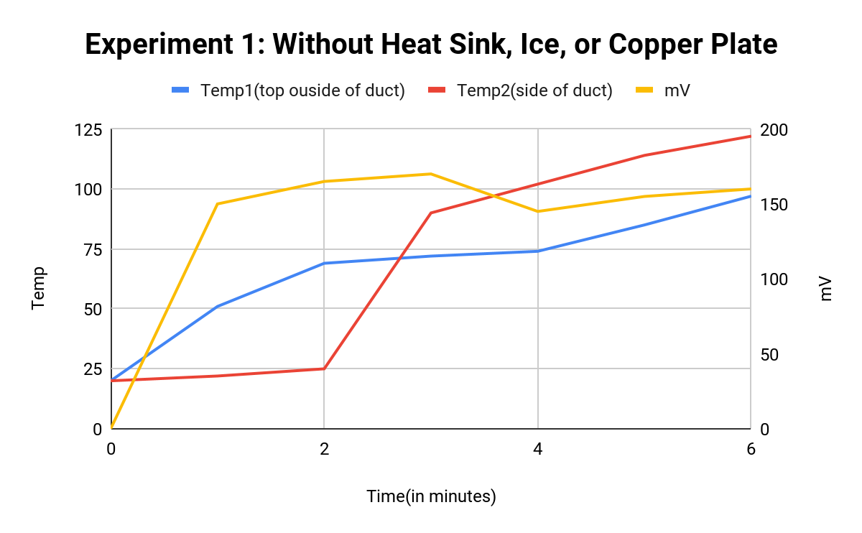
Experiment 1: Without Heat Sink, Ice, or Copper Plate
Time(in minutes) | Experiment 1: Without Heat Sink, Ice, or Copper Plate | Temp2(side of duct) | mV
0 | 20 | 20 | 0
1 | 51 | 22 | 150
2 | 69 | 25 | 165
3 | 72 | 90 | 170
4 | 74 | 102 | 145
5 | 85 | 114 | 155
6 | 97 | 122 | 160

Slide 11
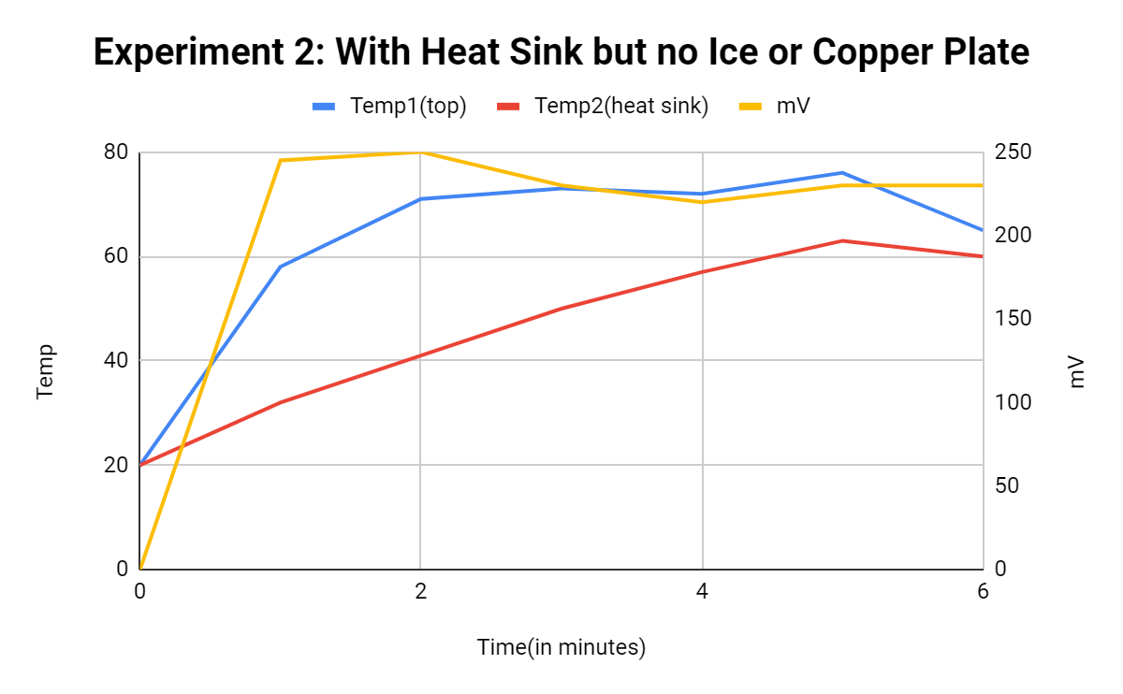
Experiment 2: With Heat Sink but no Ice or Copper Plate
Time(in minutes) | Temp1(top of duct) | Temp2(heat sink) | mV
0 | 20 | 20 | 0
1 | 58 | 32 | 245
2 | 71 | 41 | 250
3 | 73 | 50 | 230
4 | 72 | 57 | 220
5 | 76 | 63 | 230
6 | 65 | 60 | 230

Slide 12
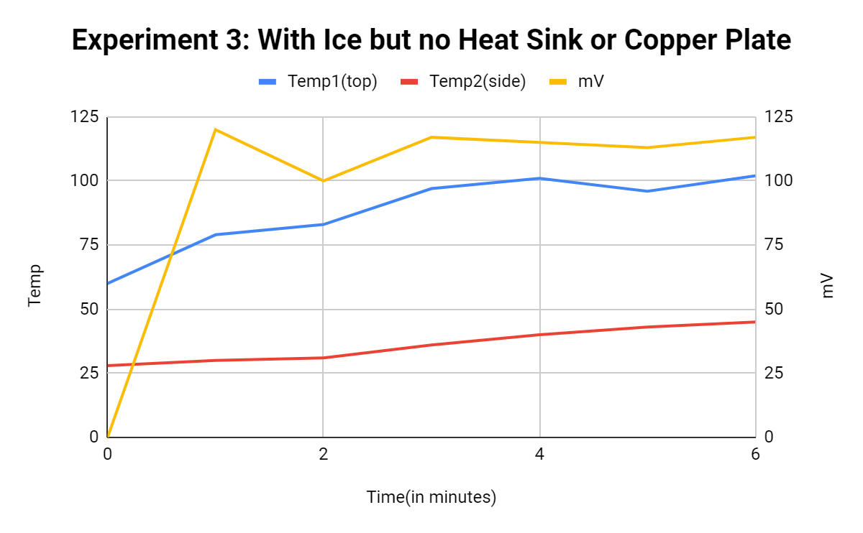
Experiment 3: With Ice but no Heat Sink or Copper Plate
Time | Temp1(top) | Temp2(side) | mV
0 | 60 | 28 | 0
1 | 79 | 30 | 120
2 | 83 | 31 | 100
3 | 97 | 36 | 117
4 | 101 | 40 | 115
5 | 96 | 43 | 113
6 | 102 | 45 | 117

Slide 13
Experiment 4: With Copper Plate and Heat Sink but no Ice
Time | Temp1(heat sink) | Temp2(plate) | mV
0 | 21 | 25 | 0
1 | 26 | 41 | 145
2 | 33 | 50 | 178
3 | 41 | 56 | 185
4 | 47 | 59 | 175
5 | 50 | 58 | 166
6 | 52 | 55 | 149

Slide 14
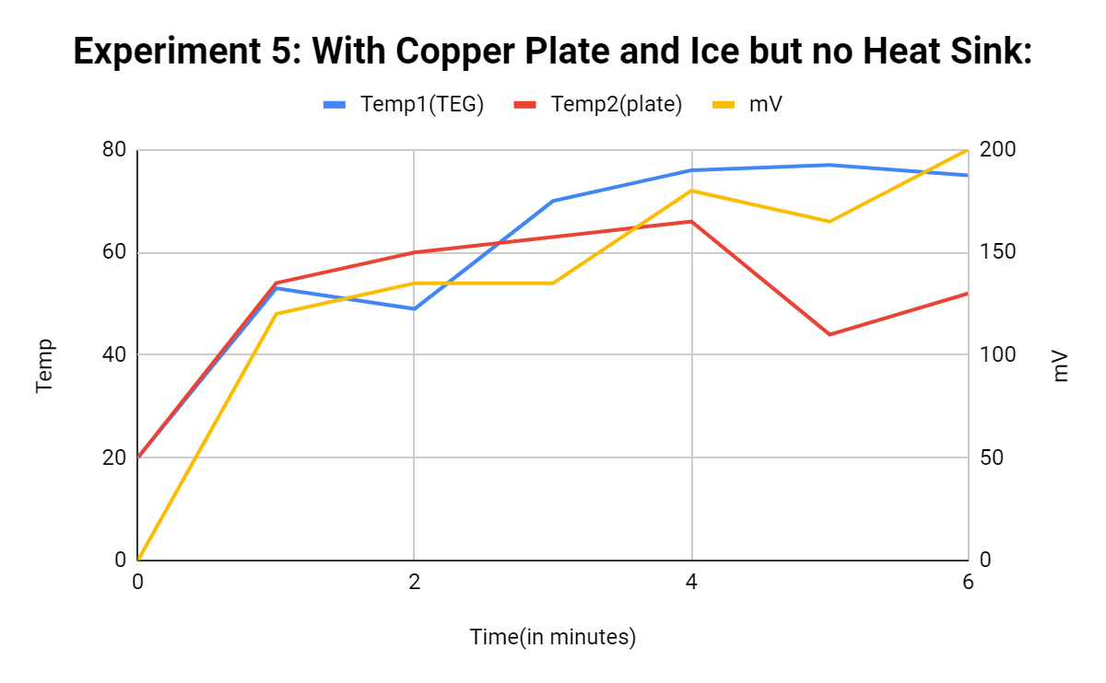
Experiment 5: With Copper Plate and Ice but no Heat Sink
Time | Temp1(TEG) | Temp2(plate) | mV
0 | 20 | 20 | 0
1 | 53 | 54 | 120
2 | 49 | 60 | 135
3 | 70 | 63 | 135
4 | 76 | 66 | 180
5 | 77 | 44 | 165
6 | 75 | 52 | 200

Slide 15
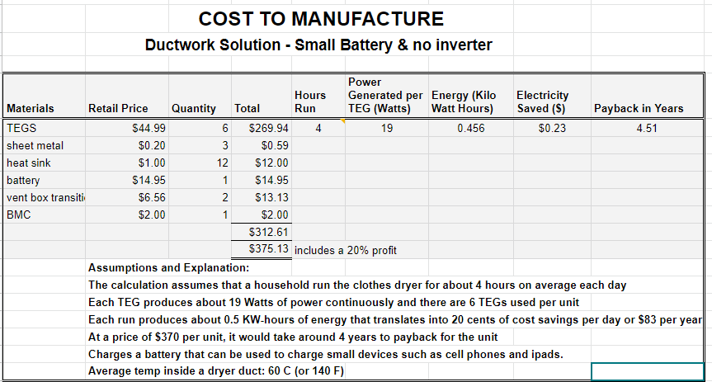

Slide 16
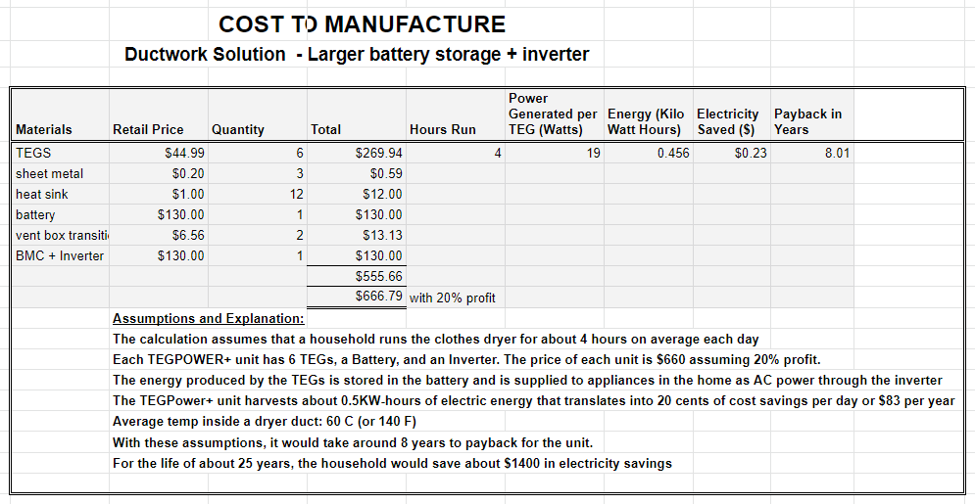

Slide 17
Payback
Version | Hours Run | Power | Energy | Price | Payback
Iterated | 4 | 19 | 0.456 | $0.23 | 4.42 Years
Cheaper, Smaller | 4 | 19 | 0.456 | $0.23 | 7.93 Years

